Slide 1
Storing & Managing Data
Jeremy Bergmann - Omaha Data Science Academy

Slide 2
Review: Class 7
Purpose of Database Modeling
Entity-Relationship Diagrams
SQL Constraints & Relational Database Modeling
Normal Forms: 1NF, 2NF, 3NF
OLAP - Dimensional Data Modeling
OLAP vs. OLTP
Notes:
Feynman technique: Learn -> Explain -> Reflect -> Repeat
What are the most important ideas from last class? Write a summary of the information as if explaining to a 14 year old. Avoid jargon Keep the words and sentences simple Rely on memory Make the explanation visual, if possible Note where you had difficulty or have knowledge gaps. These indicate things you should review, research, or ask questions about

Slide 3
Class 8 Objectives
Data Storage Terminology
Data Management vs. Administration (DBA) Data Governance & Measuring Data Quality
Data Dictionaries
Notes:
Feynman technique: Learn -> Explain -> Reflect -> Repeat
What are the most important ideas from last class? Write a summary of the information as if explaining to a 14 year old. Avoid jargon Keep the words and sentences simple Rely on memory Make the explanation visual, if possible Note where you had difficulty or have knowledge gaps. These indicate things you should review, research, or ask questions about

Slide 4
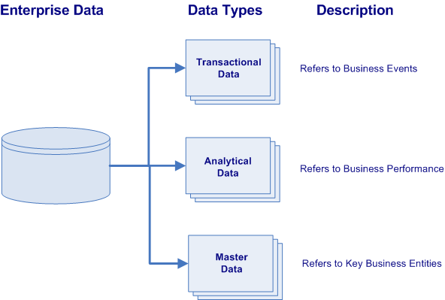
Types of Enterprise Data
All business enterprises have three varieties of physical data located within their numerous information systems. These varieties of data are characterized by their data types and their purpose within the organization.
Transactional Data (OLTP) describes the business events of an organization
Analytical Data (OLAP) supports decision making, reporting, query, and analysis (i.e. describes business performance).
Master Data represents the key business entities upon which transactions are executed and the dimensions around which analysis is conducted (i.e. describes key business entities).
Notes:
Transactional data supports the daily operations of an organization (i.e. describes business events).
Analytical data supports decision-making, reporting, query, and analysis (i.e. describes business performance).
While master data represents the key business entities upon which transactions are executed and the dimensions around which analysis is conducted (i.e. describes key business entities).
lowest granularity

Slide 5
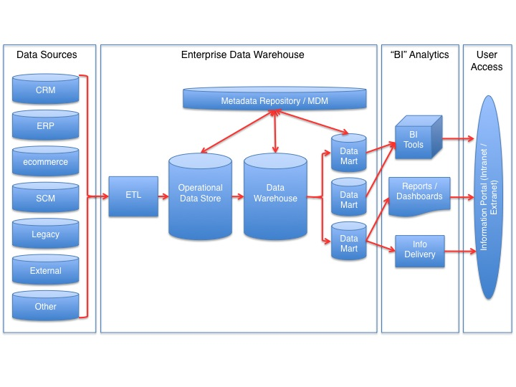
Data Storage Terminology
OLTP - Focused on the operation of a particular system - goal is to capture events.
ODS - “pulls together” data from multiple transaction processing systems and sources. Usually contains cleaned, “normalized” data
OLAP - capabilities to analyze data from multi-dimensional perspectives. Usually contains “denormalized” data
MDM: Define and manage the critical data of an organization to provide, with data integration, from a single point of reference.
Semantic Layer
(ODS)
Online Analytical Processing
(OLAP)
Online Transactional Processing
(OLTP)
Notes:
Relationship: OLTP = Source for OLAP

Slide 6
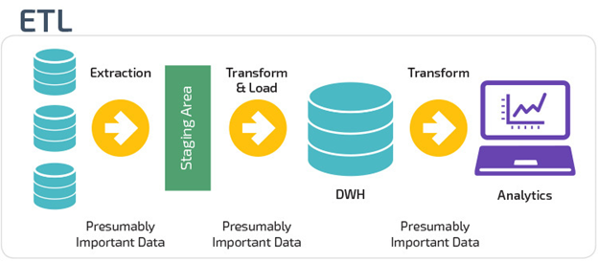
What is ETL?
ETL is short for Extract, Transform, and Load. These functions that let you take data from different formats, manipulate the data in a staging area, then write data to a target database.
The Extract stage lets you take data from different sources and allows you to pull it into a centralized staging area.
The Transform stage lets you manipulate the data with certain rules applied on the extracted data.
The goal is to load this data into the end, target database in a cleansed, uniform format.
The Load stage is the process of writing the data into the final, target database. This final target can be an operational data store, data marts, or a data warehouse.
Notes:
For example, a company may house all their data in a SQL Server database, but needs to gather their source data from Excel, CSV, Access, and JSON files. With ETL, you can take this disparate information, pull it into a staging area where you transform it, then write all the data into the target data store.

Slide 7
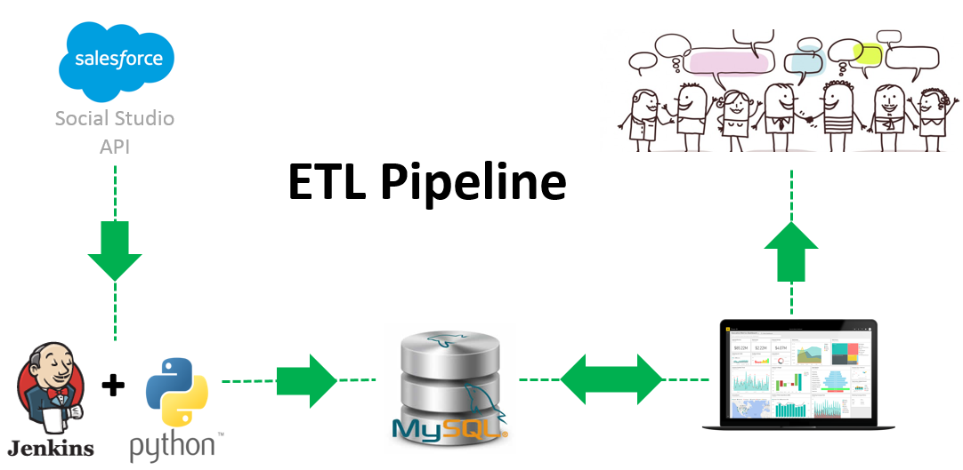
ETL Using Python
You can run an ETL process with either an ETL tool or by running custom scripts. While there are many software based ETL tools on the market, it’s becoming more and more common to create ETL processes using a scripting language.
Why Python for ETL?
Common language for data scientists and data engineers.
Libraries that include ETL processes and connections to a variety of data sources
Databases, Files, APIs, etc.
Flexible - Adjust “on the fly” to specific project needs.
The processes are also known as “Data Pipelines”.
Python ETL & Data-Cleaning Example - Google Drive - Jupyter Notebook
Notes:
Note: Install Anaconda - Pandas, Numpy & PyMySQL packages
Run Python from Command-line in Windows, or juypter notebook
Save your python code file somewhere, using "Save" or "Save as" in your editor. Lets call it 'first.py' in some folder, like "pyscripts" that you make on your Desktop.
Open a prompt (a Windows 'cmd' shell that is a text interface into the computer):
start > run > "cmd" (in the little box). OK.
Navigate to where your python file is, using the commands 'cd' (change directory) and 'dir' (to show files in the directory, to verify your head). For our example something like,
> cd C:\Documents and Settings\Gregg\Desktop\pyscripts
try:
> python first.py

Slide 8
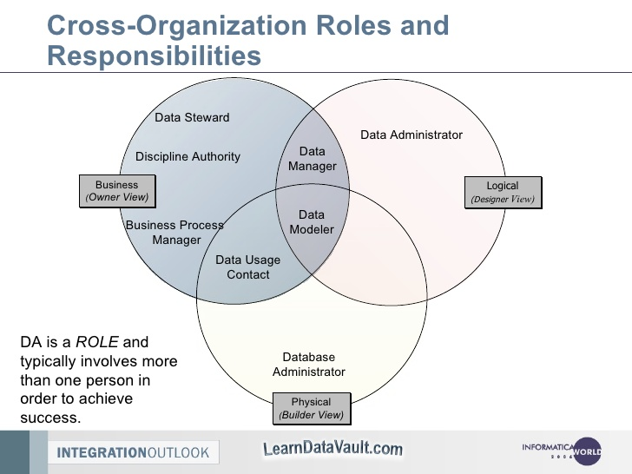
Data Management vs. DBA
What is Data Management?
Data Management (Stewardship) is the practice of organizing and maintaining data processes to meet ongoing information lifecycle needs. This includes data creation, storage, processing, archiving, and data destruction.
What is Database Administration (DBA)?
Database administration is the use of specialized software to store and organize data. This is the technical aspects of the planning, installation, configuration, design, migration, performance monitoring, security, troubleshooting, backup, and data recovery of a database system.
What are the Similarities Between the Two Roles?
Professionals in both specializations coordinate the database planning, goals, design, and communicate actions while the project is being implemented.
What are the Differences?
Data management focuses on the “Logical” design - planning, organization, and design of a database system. DBA’s focus in the physical design of the database performance, storage, access, backups, etc.
Notes:
Approaches to data management eventually permeated what came to be known as the data lifecycle, spanning data creation, storage, processing, archiving and, sometimes, data destruction.

Slide 9
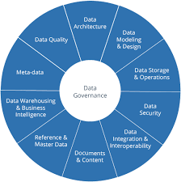
Data Governance & Stewardship
What is Data Governance?
Data Governance is a quality control discipline for assessing, managing, using, improving, monitoring, maintaining, and protecting organizational information.
What is a Data Steward?
This is a position within an organization that ensures data governance processes are followed, guidelines are enforced, and recommends improvements to be made to data governance processes.
Notes:
It is a system of decision rights and accountabilities for information-related processes, executed according to agreed-upon models which describe who can take what actions with what information, and when, under what circumstances, using what methods

Slide 10
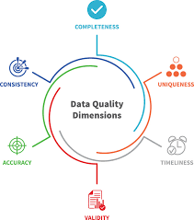
Measuring Data Quality
What is Data Quality?
Sometimes errors or incorrect elements are present in your data set. It’s important to be proactive in cleaning data and periodically testing it for inaccuracies.
What is a Data Quality Assessment?
You can identify these errors and understand their implications by both qualitative assessments and quantitative measurement. This will improve data quality processes for quality and effectiveness.
What is an Example of Measuring Data Quality?
Data quality metrics track how the number of known errors in a dataset, such as: such as missing, incomplete or redundant entries. If fewer errors while the size of your data stays the same or grows, you know that organizational data quality is improving.

Slide 11
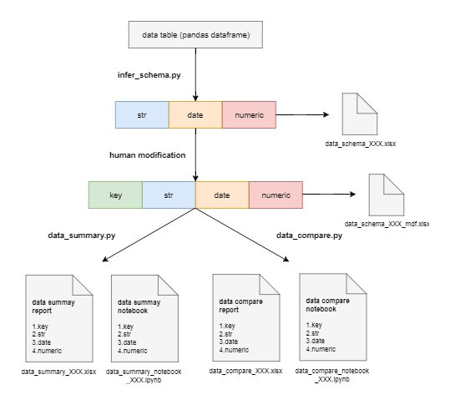
Data Quality Using Python
There are ways to monitor and measure data quality with Python. Some of these libraries can help with the following tasks:
Data Integration
Data Cleansing
Data Monitoring
Data Auditing
Investigating Unknown Datasets
Pydqc is a python libraries used to clean data, run summary
calculations, and add automatic data quality checks.
The library allows a user to load the data (via Pandas DataFrame),
infer the dataset schema and generate a summary of your data.
Library Documentation: https://github.com/SauceCat/pydqc
Examples: (Juypter Notebook) https://github.com/SauceCat/pydqc/blob/master/test/pydqc_test_on_Zillow.ipynb

Slide 12
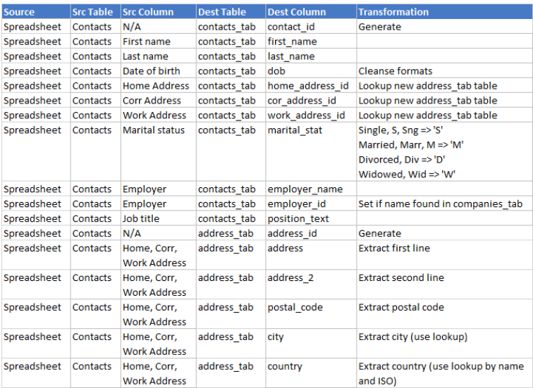
Data Dictionaries
What is a Data Dictionary?
A Data Dictionary is a collection of sources, names, definitions, and attributes that define the data elements captured in a system.
The data dictionary contains information about:
Names and physical information of all database schemas, tables and fields.
“System of record” Source information.
Table constraints such as primary key attributes, foreign key information etc.
Business rules, transformations and metadata about field values.

Slide 13
Project Milestones
Query Data for Data Understanding/Relevant Information (Class 2)
Import data into MySQL database (Class 3)
Storing/Joining data for analysis (Class 4)
Cleaning Data (Class 5)
Create Automated Processes using Stored Procedures & Functions (Class 6)
Normalize Data & Create Data Model (Class 7)
Analyze Data Quality & Create Data Dictionary (Class 8)
Finalize Project - Connect MySQL to PowerBI Cloud, Answer Business Questions (Class 8)

Slide 14

Class Project
Data Dictionary
1. Create a Data Dictionary for the “Consoles” schema, highlighting the original data source, database schema/table, fields values/types and business significance.
Power BI - Connect
1. Import the views you created in the “Consoles” schema into Power BI’s “Relationships” view.
2. Re-Create the entity relationships in last week’s ERD, by adding relationships via the data modeling view in Power BI.
Data Quality (Extra Credit)
1. Analyze Data Quality with Python code, via the Jupyter notebook (Python_DataQuality.ipynb) located in the “Examples” folder.
Notes:
If error that cant find python library: https://stackoverflow.com/questions/43437884/jupyter-notebook-import-error-no-module-named-matplotlib

Slide 15


